Slide 1
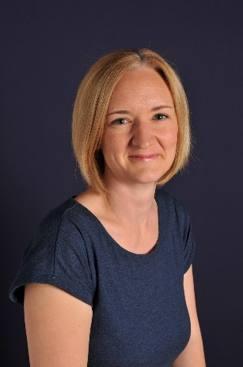
Meet the Teacher
Year 3
Mrs Moss

Slide 2
The Year 3 Team:
> Teachers – Mrs Moss & Mrs Bluck
> Teaching Assistants – Miss Birchall, Miss Bailey & Miss McManus

Slide 3
The school day :
> Arrive: 8.45am
> Playtime: 10.30am – toast or fruit/veg sticks (eaten before playtime)
> End of Day: 3.20pm – school playground right hand side of MUGA

Slide 4

Behaviour :
Class Charter agreements:
> Show Kindness
> Show Respect
> Do Our Best
> Be Ready to Learn

Slide 5

I-Pads :
> E-Safety / Rules for safe use
> Help with focus
> Respond on I-Pads
> Own logins

Slide 6
Important information :
> Reading:
Expectation of at least 10 minutes daily practice at home – please sign diary
Reading Books will be changed as needed.
> Spelling:
Spellings will be sent home weekly to practice for a test (usually on Thursdays)
> Times Tables:
Times Table Rock Stars codes will be added to reading diaries to allow for practice at home

Slide 7
Important information :
> PE days – Tuesday and Forest school on Fridays (Autumn 1)
> Uniform – We expect children to be wearing correct uniform and footwear
> School lunches – these should be ordered the day before via ParentPay

Slide 8
Important information :
> Swimming – before October half term
> Spring Term Production – with Year 4
> House Points / Track Its – rewards for positive behaviour, attitude and effort that build up to Bronze, Silver and Gold Awards
> Newsletters / Email – Keep up to date about assemblies etc.

Slide 9


Working together :
If you have any questions, please feel free to speak to me at the end of the day on the playground or make an appointment through the office.
Thank you for your support.
We have had a great start to the school year!

