Slide 1

Year 5
Mrs Grainger & Mrs Flintoff

Slide 2
Class Rules
In our class, we:
will be Kind
will Be Respectful
will be Ready to Learn
will Try our Best

Slide 3
Reading
Children are expected to read EVERY day – please take 5/10 minutes to listen to your child; this could be before bed, in the morning before school, whenever is convenient for you. It doesn’t have to be for long but doing this daily is the key to becoming fluent readers – this is a real focus for us this year
Reading books should be returned to school EVERY day as we will also be reading with them and books will be changed every FRIDAY – this is the same for every class to make it easier to remember if there are siblings.

Slide 4
Spellings
Apellings will be sent out on Thursday.
Spelling tests will also take place on Tuesday.

Slide 5
P.E.
P.E. will be on Thursday – full P.E. kit should be worn with appropriate trainers
Swimming – this will take place in the next half term so advance warning now that children will need a swimsuit, a swimming cap and a towel.

Slide 6

Bikeability
These sessions will take place on Thursday 19th and Thursday 26th – we do not have space to store bikes so these will have to come to and from school on the same day. Don’t forget a helmet as well!

Slide 7
Uniform
Children must wear correct uniform at all times – no earrings are allowed, children will be asked to remove them and plastic clear studs put in place
WATER BOTTLES
These must be no larger than so they can fit into the bottle holders – water only, no juice

Slide 8
School dinners
If your child has a school dinner, it would be really helpful if this was ordered online in advance please – it takes additional time in the mornings to make sure everyone has ordered a lunch

Slide 9
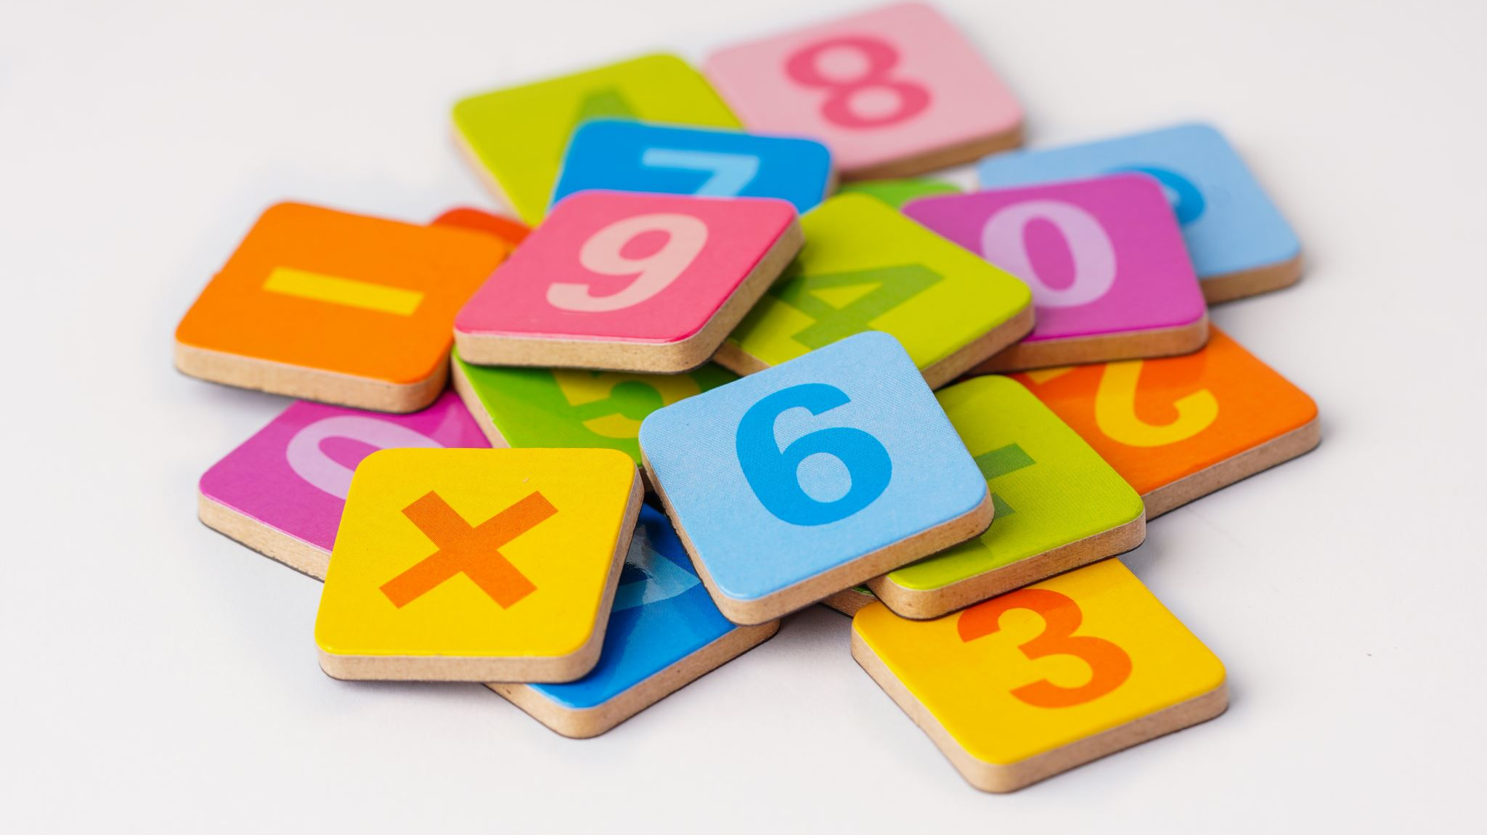
Tt rockstars
All children have a login for this – we will practise in school but please practise these at home as well!

Slide 10
Subject overview for this year
English – The Lion, the Witch and the Wardrobe; The Christmas Truce; David Attenborough; The Highwayman (poem); Fantastic Flying Books of Mr Norris; Screen Time; Cosmic; The Most Dangerous Animal in the World; Explorer; Scott of the Antarctic
Science – Space; Materials; Circle of Life; Let’s Get Moving; Growing up and Growing Old
History – Anglo-Saxons; Vikings; Journeys
Geography – Americas; Alpine region study; Journeys
Art – Collage; Sculpture
DT – Stuffed Toys; Cooking; Mechanical systems, Pop Up Books
RE – Creation & Covenant; Promise and Prophecy; Galilee to Jerusalem; Desert to Garden; To the Ends of the Earth; Dialogue and Encounter

Slide 11
Celebration assemblies
These are held every Friday morning – you are all welcome to attend and share in the celebration of the fantastic work the children do. It isn’t possible to inform parents of all awards awarded.
There is a class assembly once a year and we will let you know when Year 5 will be doing theirs – we would love you to join us.

Slide 12
Contact
You can always speak to me at the end of the day at pick up or you can also email the school if you want to arrange a time to speak.
If you have any issues or concerns at all, please do let me know. Also, please let us know if there is anything you think we need to be aware of.

