Slide 1






Year 5
Mrs Grainger, Mrs Eland and Mrs Pickering

Slide 2
Class Rules
In our class, we will:
  Be Kind
  Be Respectful
  Be Ready to Learn
  Try our Best

Slide 3

Reading
Children are expected to read EVERY day – please take 5/10 minutes to listen to your child; this could be before bed, in the morning before school, whenever is convenient for you. It doesn’t have to be for long but doing this daily is the key to becoming fluent readers – this is a real focus for us this year.
Reading books should be returned to school EVERY day as we will also be reading with them and books will be changed every FRIDAY.

Slide 4




Home Learning will be sent out on Friday.
This should be completed and brought in by Wednesday.
Spellings

Slide 5
P.E.
P.E. will be on Wednesday and Thursday – full P.E. kit should be worn with appropriate trainers
Swimming – this will take place at the end of this half term so advance warning now that children will need a swimsuit, a swimming cap and a towel.

Slide 6
Children must wear correct uniform at all times – no earrings are allowed, children will be asked to remove them and plastic clear studs put in place
Uniform
WATER BOTTLES
These must be no larger than 23cm so they can fit into the bottle holders – water only, no juice

Slide 7
School dinners
If your child has a school dinner, this should be ordered online in advance – it takes additional time in the mornings to make sure everyone has ordered a lunch so ordering beforehand really speeds up the process.

Slide 8
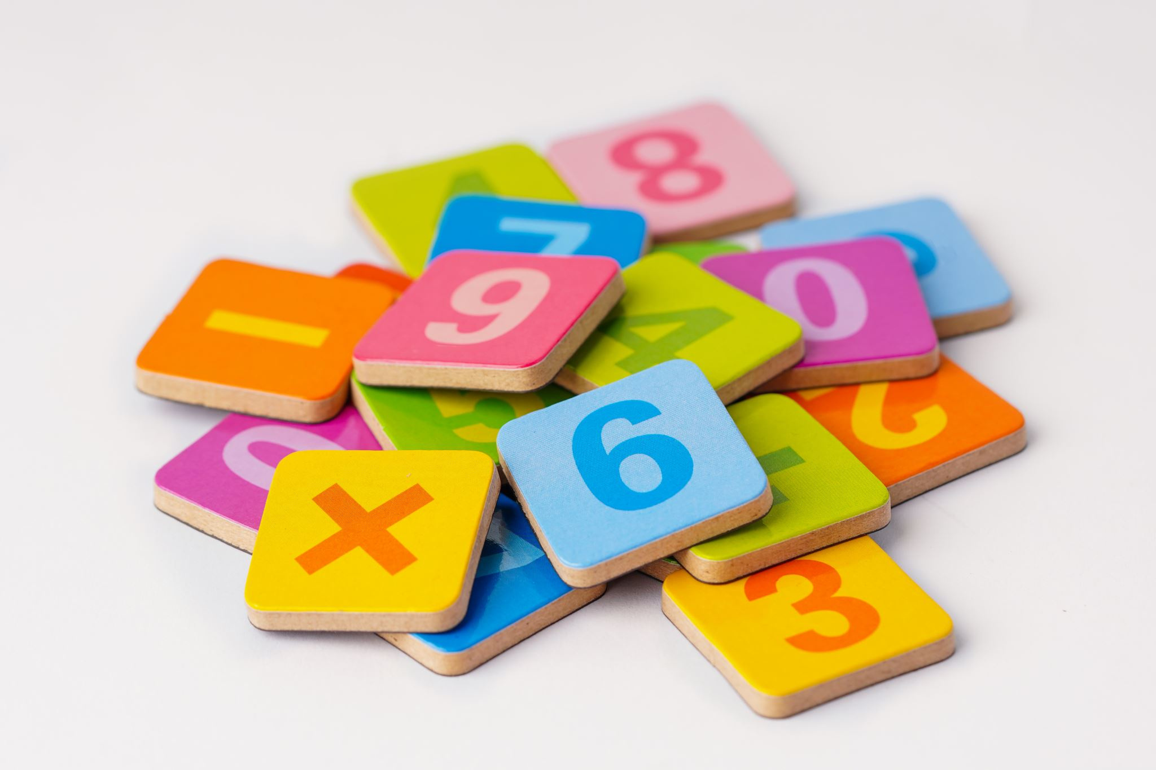



TT Rockstars
All children have a login for this – 20 minutes minimum each week at home

Slide 9
Subject overview for this year
Writing – Letters of Application, Biographies, Playscripts, Third Person stories set in another culture, First Person stories myths and legends, Balanced Arguments, Poems
Reading - Shackleton’s Journey, The Explorer, Boy in the Tower, A Midsummer Night’s Dream, I am not a Label, Secrets of a Sun King, 5 Children and IT
Science – Properties and changes in materials, Earth in Space, Living things, Animals (inc. Humans), Forces
History – Ancient Greece, Comparison between Britain and the Mayans
Geography – Wolrld countries and biomes, Map Skills
Art – Painting and Drawing, £D Block, Printmaking, Textiles and Collage
DT – Food and nutrition, Systems, Textiles, Structures, Mechanisms
RE – Creation & Covenant; Promise and Prophecy; Galilee to Jerusalem; Desert to Garden; To the Ends of the Earth; Dialogue and Encounter

Slide 10




Celebration assemblies
These are held on Friday mornings – you are all welcome to attend and share in the celebration of the fantastic work the children do. It isn’t possible to inform parents of all awards awarded. You will be informed the week before if your child is going to receive an Aspire to Inspire Award.
Year 5 will be holding a class assembly on Friday 10th October - please join us!

Slide 11
Contact
You can always speak to me at the end of the day at pick up or you can also email the school if you want to arrange a time to speak.
If you have any issues or concerns at all, please do let me know. Also, please let us know if there is anything you think we need to be aware of.

