Slide 1
Class Five
Meet the Teacher

Slide 2
General information
PE day: Wednesday (Physical Education) & Thursday
(Swimming). Coloured house team top, blue jumper and blue joggers, with comfortable black/blue trainers.
Forest School: Will begin soon and a letter will be going out from Miss Orme.
Reading books: Changed on a Monday
Homework: Homework will go out on a Friday, and comes back in on the Wednesday. This will be a Maths, English or Topic task, alongside daily reading and spelling practise. The children will bring the work home in a plastic wallet and will need to bring it back in the same condition on the Wednesday.
Spellings: Go out on a Friday and the test is the following Wednesday
WATER BOTTLES – Please bring a water bottle for class separate to your lunch time drink. These need to be taken home, washed and brought back with fresh water in.

Slide 3
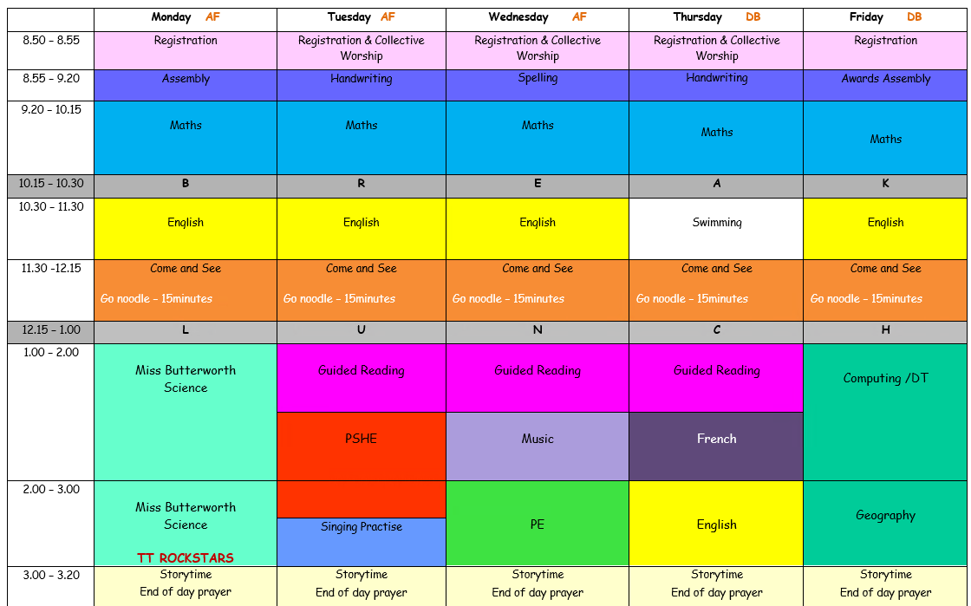
This is the timetable overview in year five for the week. As you can see, there is a lot to fit in. These are the government expectations and equip the children ready for their journey into year six and beyond. I’m sure you will agree, this is only possible if the children are listening in lessons and focusing on each task, so we can all have fun whilst learning and making progress.

Slide 4
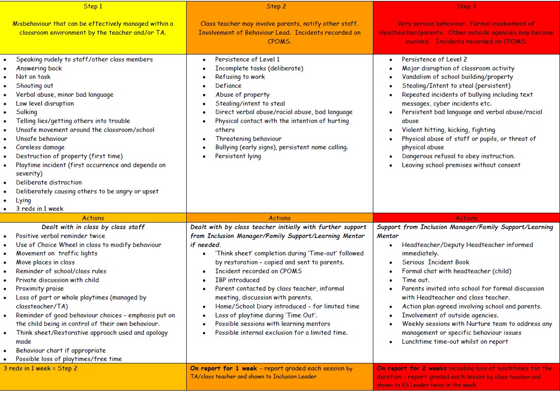
Behaviour and Expectations
Our behaviour system is called Track it lights. The children collect points that make up their Bronze, Silver, Gold, Platinum and Diamond certificates. As well as this, the children use these for behaviour steps: Green, Amber, Yellow and Red. Step 1, 2 and 3 will be followed if the below behaviours are presented.

Slide 5
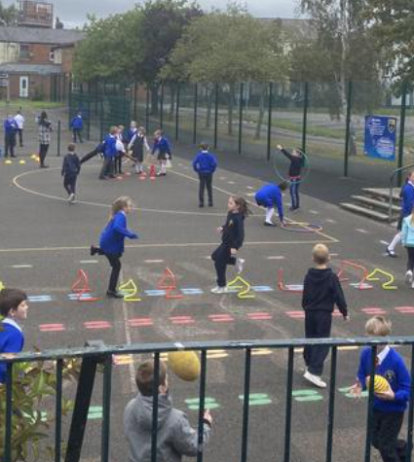
Extra Curricular
  There are many extra activities that year five can participate in over the year, the children will be notified of these prior to the event.
  We have our class assembly on Remembrance in November. More details will follow on the newsletter.
  We have Bikeability in the Spring Term 2023.
  The children can nominate themselves for extra responsibilities:
  Librarian
  Playground leader
  Pupil Mentor
  Money Mentor (Debt Aware)

Slide 6
Questions…
If you have any questions, please do ask questions at the end of the day on pick up or contact the school office to make an appointment.
bursar@st-annes.lancs.sch.uk
Thank you so much in advance and I will look forward to meeting you all at parents evening in the future.
Miss Fenton and Mr Bradshaw

Slide 7
Useful websites
Daily ten for mental maths
https://www.topmarks.co.uk/maths-games/daily10
TT Rockstars for times table practise
https://ttrockstars.com/
Top Marks and BBC Bitesize for revision
https://www.bbc.co.uk/bitesize/levels/zbr9wmn
‘Go noodle’ for physical and mental wellbeing support
GoNoodle
Word Hippo for all things, words!
Thesaurus and Word Tools | WordHippo

