Slide 1


Class 6
Meet The Teacher
Miss Whittle

Slide 2
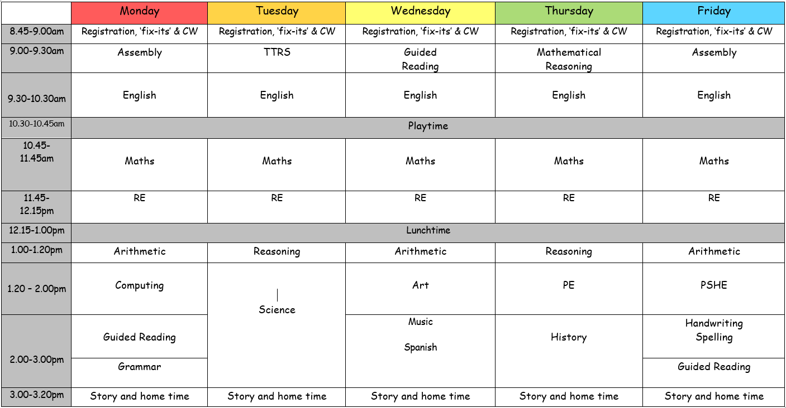
Our Timetable

Slide 3
PE days: Thursday and Friday
Coloured house team top, school hoodie and blue or black joggers/shorts, with comfortable trainers.
Reading books: Reading books need to be brought into school every day so that we can listen to children read at least once a week in school. Books will be changed every Friday; children are expected to finish reading their whole book at home through the week.
Spellings: Go out on a Friday and the test is the following Wednesday.
General Information

Slide 4
Extra-Curricular
  This year is a perfect time for your child to try something new as we have a variety of many different extra-curricular clubs throughout the year. Please keep your eyes on Parent Pay to book your child on to any of these clubs.
  This year, we will continue to try our best to take the children on a trip, and the children will have a class assembly as well as their end of year production. More details will follow on the school newsletter. As part of the children’s learning, we will also be inviting families in to school on occasion; children will be informed of this in class but information and invites will also be sent through our school newsletter.
  We have swimming lessons starting again which will take place in November.
  The children can nominate themselves for extra responsibilities:
  Librarian
  Playground leader
  Pupil Mentor
  Subject ambassadors

Slide 5
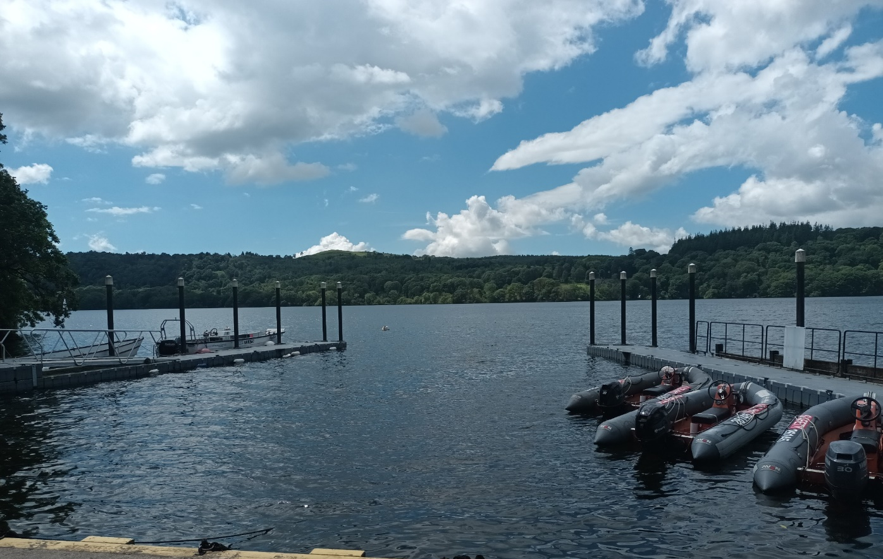
Residential
In June we will venture to the shores of
Windermere and enjoy a whole four days of outdoor activities
at Tower Wood.
Details of payments will be on Parent Pay in the next week or so, but
I will inform the children and send a text home to inform you when it is on Parent Pay.
Outdoor activities will include some of the following:
Ghyll scrambling, hiking, kayaking, rock climbing, mountain biking, high ropes.
The residential is an incredible experience for all children. The instructors are qualified instructors who tailor activities to the needs of our children.
We will be hosting an information evening closer to the time to provide further details of timings, sleeping arrangements and equipment lists. This will coincide with our SATs information evening.

Slide 6

SATs
SATs are the end of Key Stage 2 statutory assessment tests which assess
children’s learning and understanding from year 3 – 6.
The will take place on the week commencing 11th May and will follow the
timetable below.
This year, you can support your child even further by listening to them read on a daily basis, and questioning them about the text. After Christmas, children
will receive a revision guide. Any help and support with
this will be greatly appreciated.
Further advice and support will be provided closer
to the time through an information evening.
Monday | 1 - Grammar and Punctuation 2 - Spelling
Tuesday | English Reading
Wednesday | Maths Paper 1 – Arithmetic Maths Paper 2 – Reasoning
Thursday | Maths Paper 3 - Reasoning

Slide 7
Useful Websites
  Daily ten for mental maths
  https://www.topmarks.co.uk/maths-games/daily10
  TT Rockstars for times table practise
  https://ttrockstars.com/
  Top Marks and BBC Bitesize for revision
  https://www.bbc.co.uk/bitesize/levels/zbr9wmn
  ‘Go noodle’ for physical and mental wellbeing support
  GoNoodle
  Word Hippo for all things, words!
  Thesaurus and Word Tools | WordHippo

Slide 8
If you have any questions, please feel free to catch me at the end of the day on the playground or make an appointment through the office.
Thank you for your continued support.
We have had a fantastic start to the school year and have no doubt that this will continue.

