Slide 1


CLASS 5
COMMUNITY PROJECT
CRIMINAL DAMAGE

Slide 2
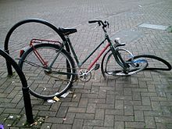

Slide 3

A person who, without lawful excuse, destroys or damages any property belonging to another, intending to destroy or damage any such property, or being reckless, as to whether any such property would be destroyed or damaged, shall be guilty of an offence.

Slide 4
This is when a child becomes criminally responsible for their actions and the consequences of their actions. From this age onwards, they can be prosecuted for any criminal offence in a Youth Court.

Slide 5
Are you 10 years old?
You need to listen very carefully!

Slide 6
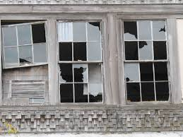
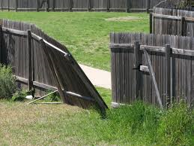

Slide 7
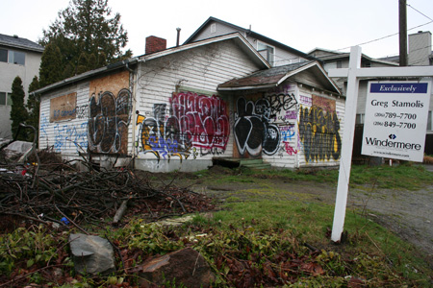
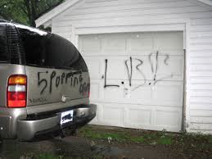
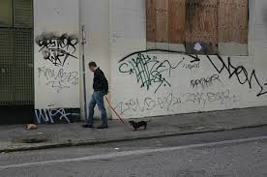

Slide 8
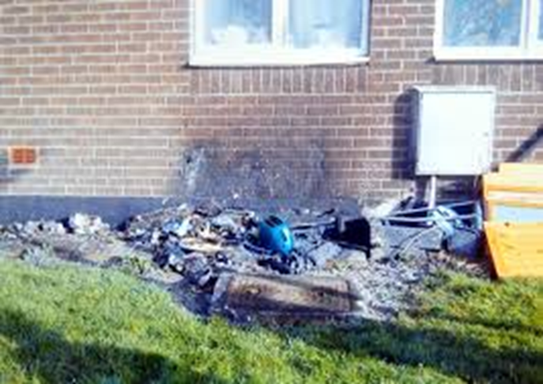
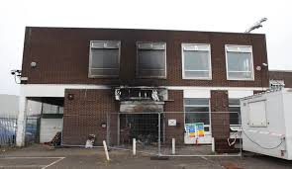

Slide 9
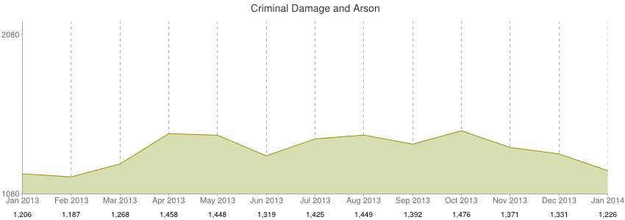

Slide 10
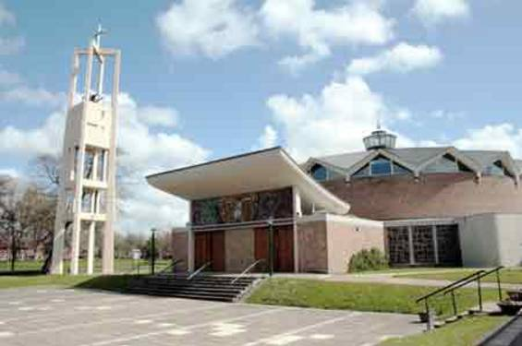
St. Mary’s Church

Slide 11
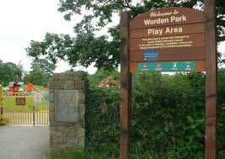
Worden Park Play Area

Slide 12
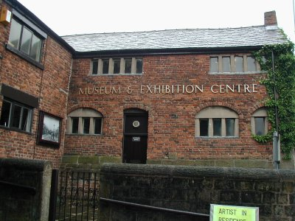

Old Grammar School Museum

Slide 13
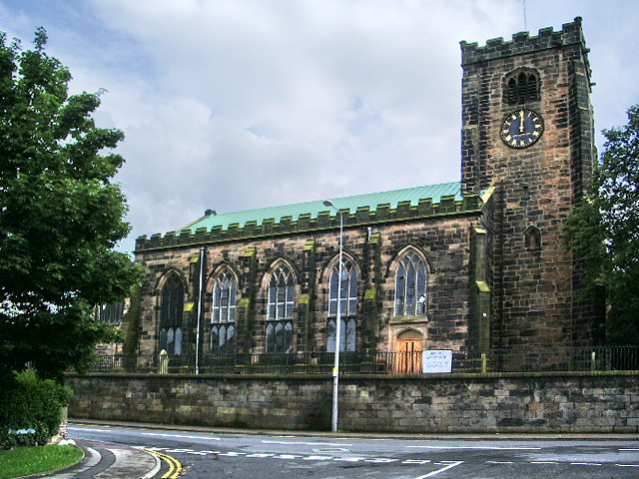
St. Andrew’s Parish Church

Slide 14
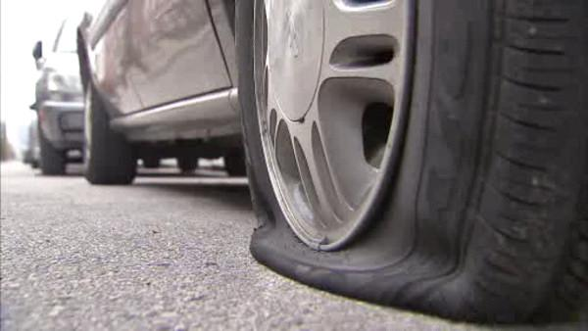
Car damage

Slide 15

Keep a look out for damage being caused.
Think carefully about who we spend time with and what we do outside.
Remember, once we are 10, we are responsible for our actions!

Slide 16
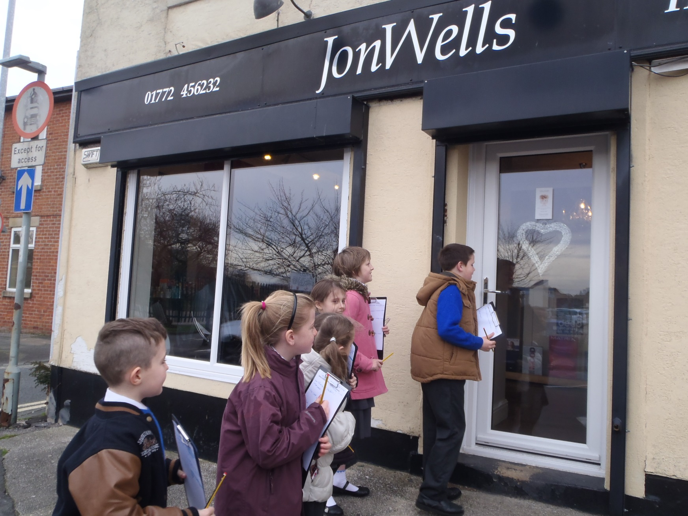
Lots of damage here, especially to the front of the shop – the door and windows.
Security shutters have made a big difference.
The hairdressers

Slide 17
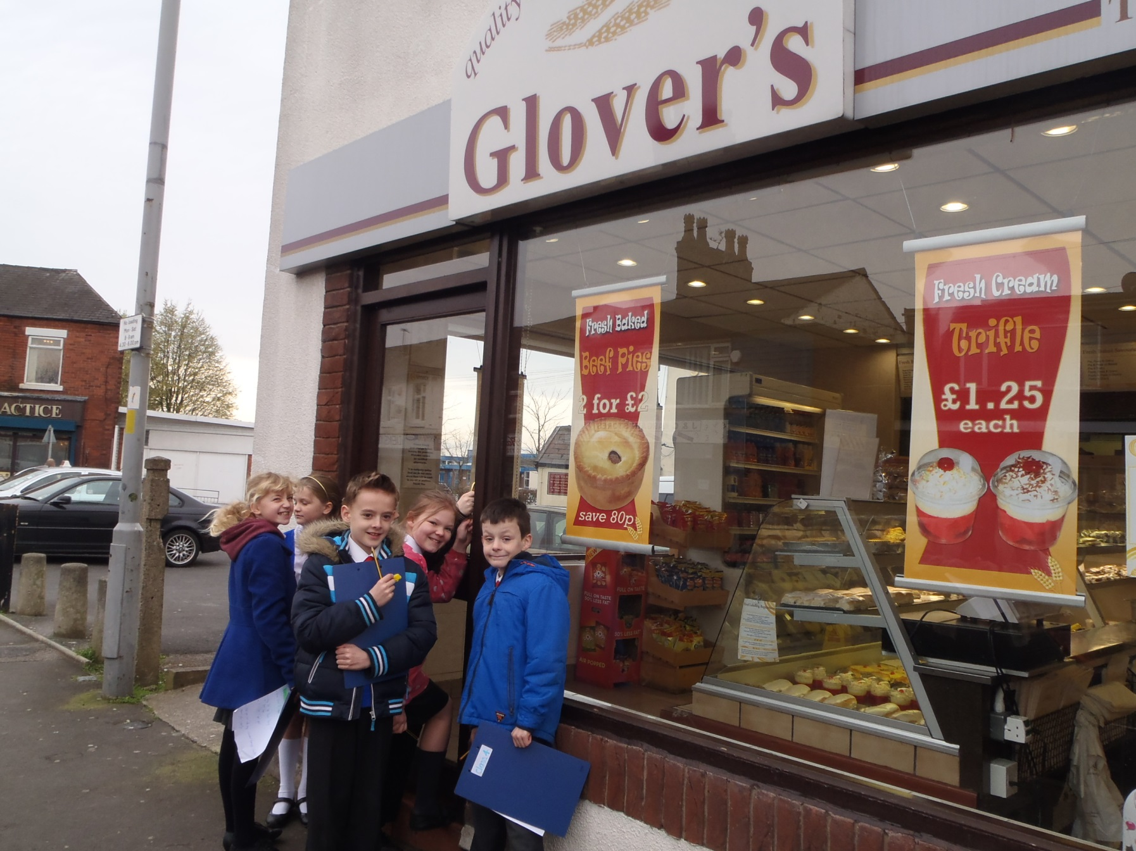
No damage at all at Glovers.
The staff think it is because people like their food and do not want the shop to be closed.
The bakery

Slide 18
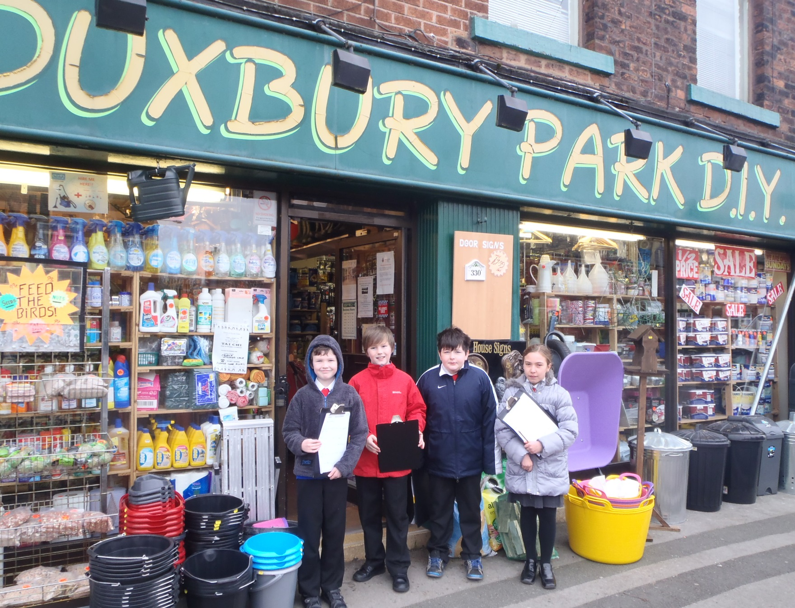
Some damage, mainly to the windows.
The owner does not want to get shutters, because they are ugly and spoil how the shop looks.
The D.I.Y. store

Slide 19
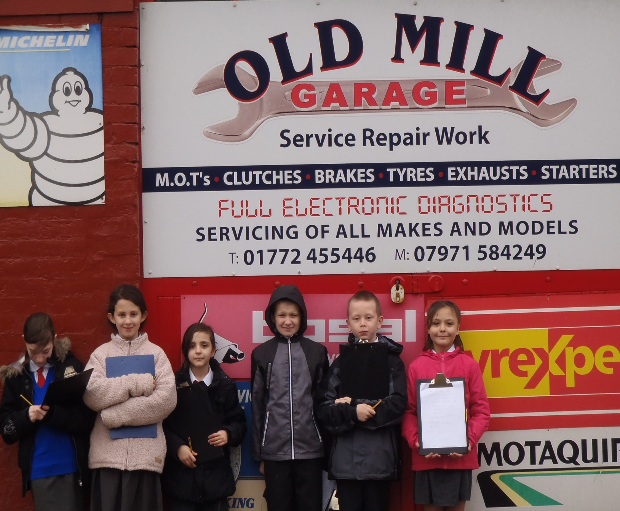
15 years ago a car was damaged on the front car park.
Since then,
there have been no problems.
They have security shutters and CCTV cameras to protect them.
The garage

Slide 20
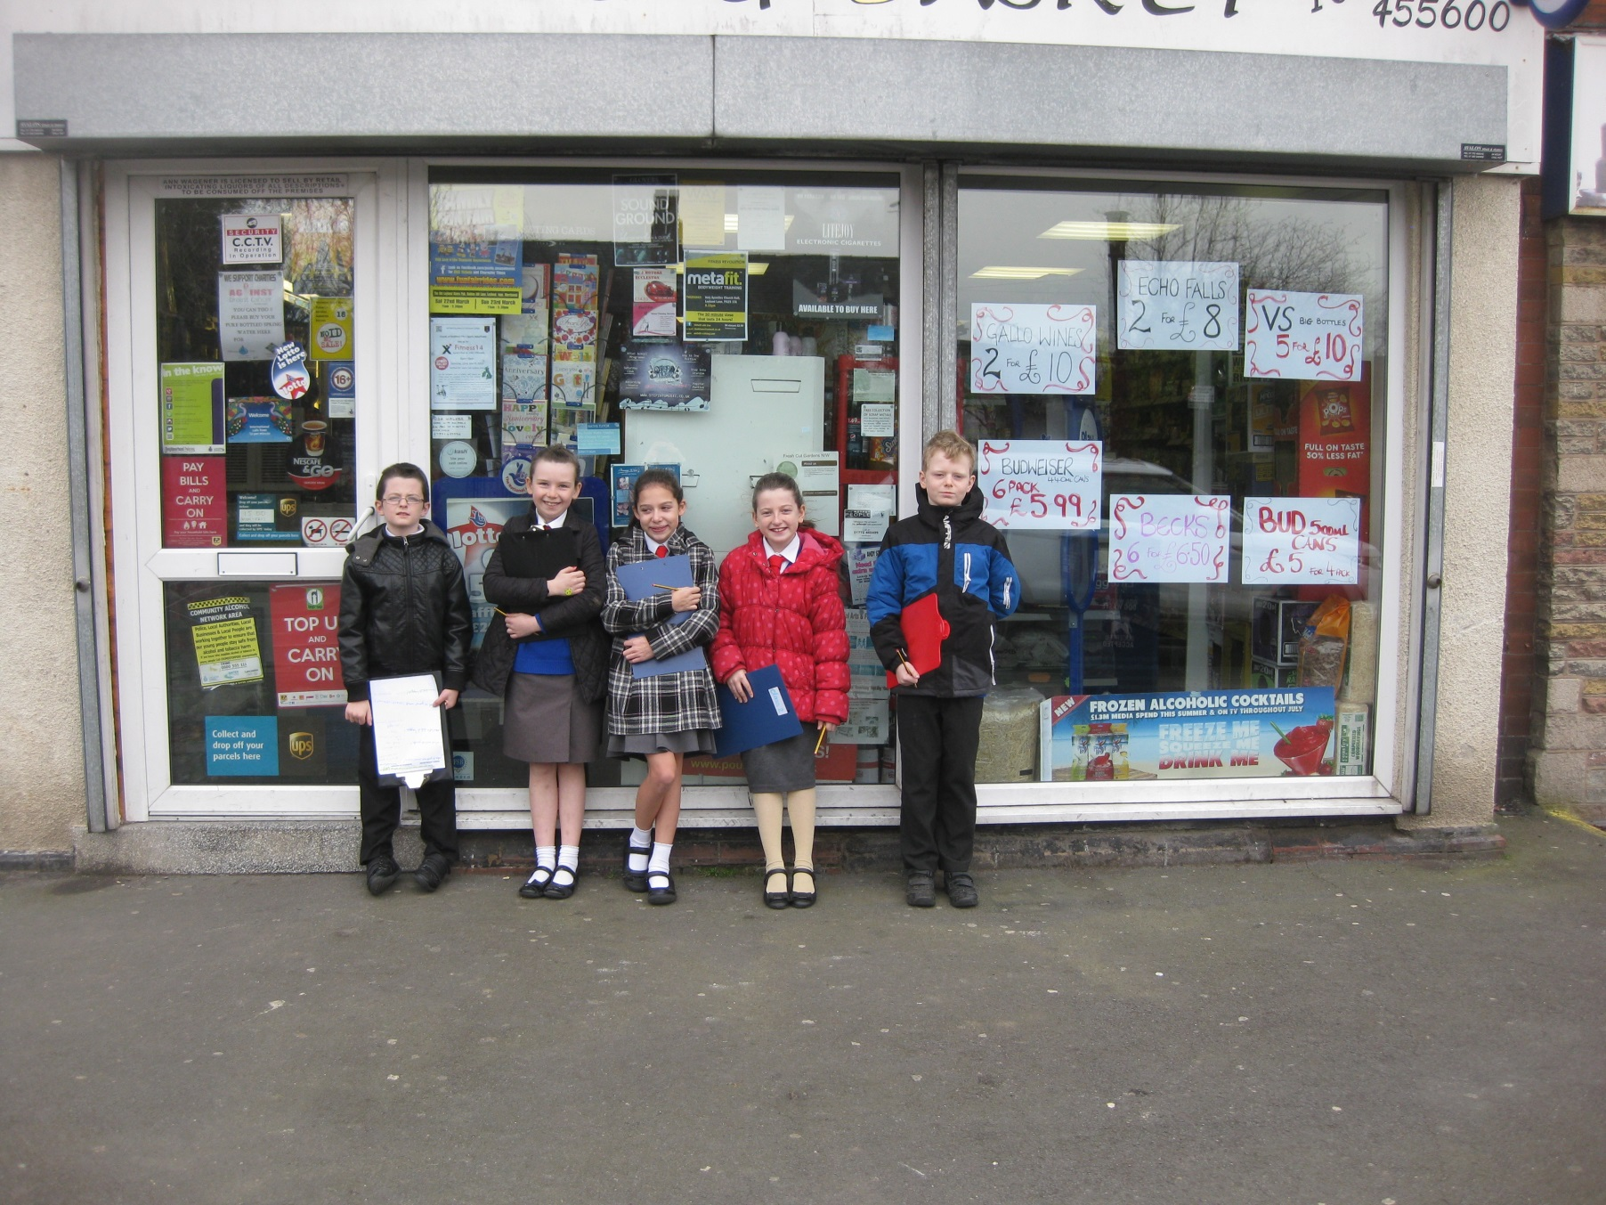
The Bottle & Basket have had lots of damage problems.
It is mainly caused by adults who come into the shop after they have been in the Pub.
Once, the damage was so bad, the shop had to close for 3 months.
The Bottle & Basket

Slide 21
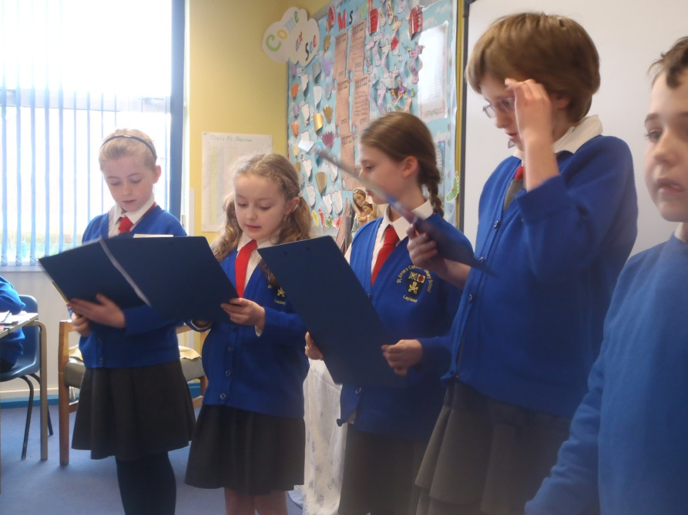
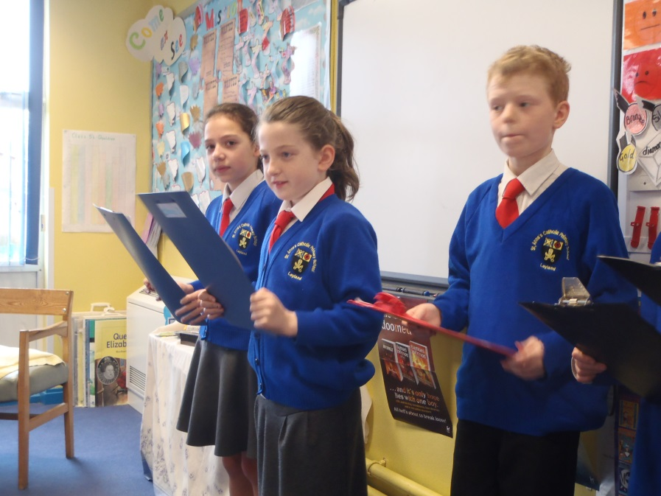
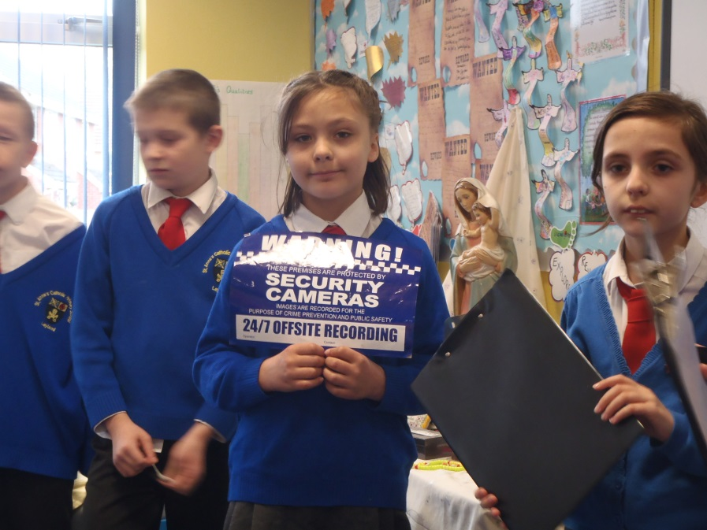
We reported all our information to each other when we got back to school.

Slide 22
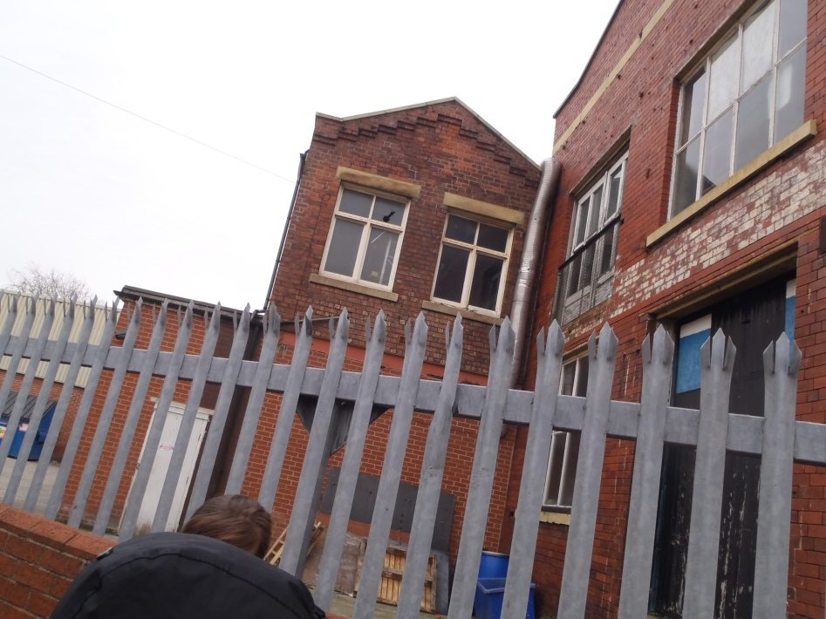
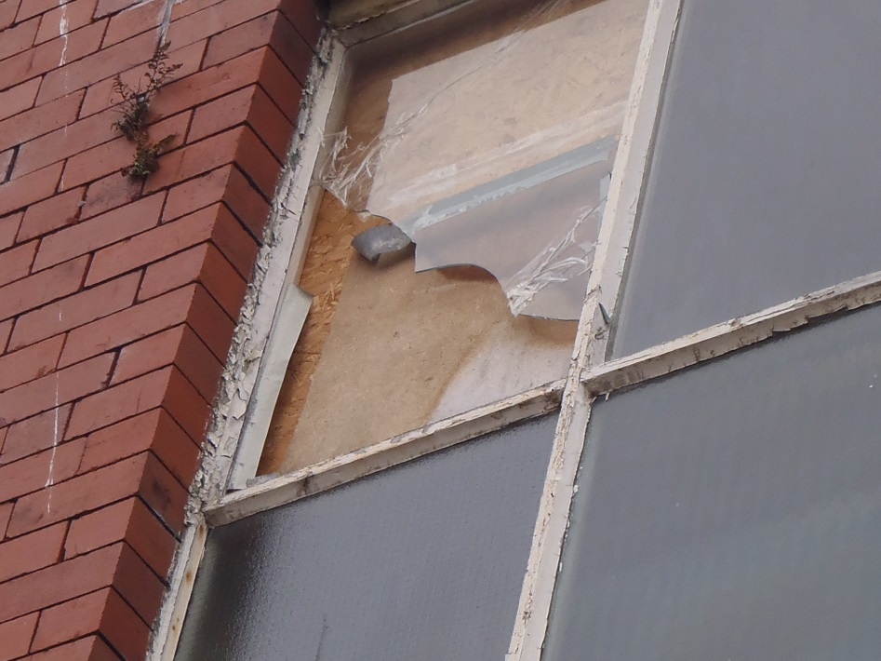
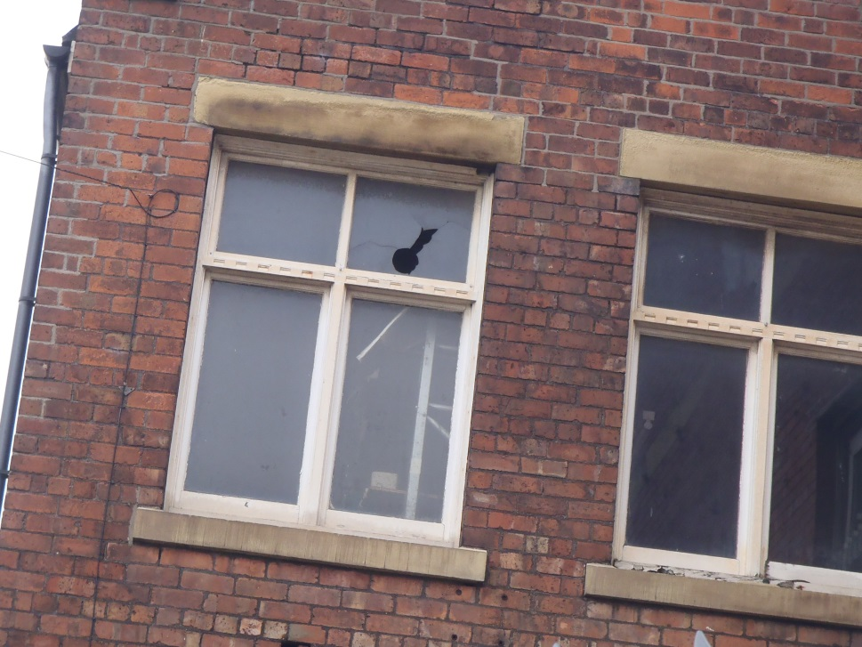
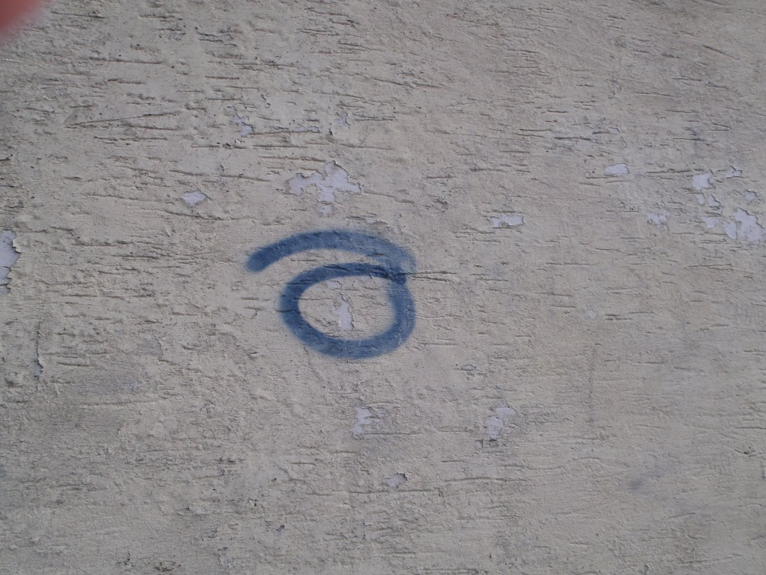
Criminal damage close to our school –
broken windows and graffiti.

Slide 23

RESTORATIVE JUSTICE
The criminals apologise to the people whose property they have damaged.
PCSO Tony makes them realise how they have hurt these people as well as damage their property.
CRIMINAL DAMAGE costs more
than money!

Slide 24

Our Song
‘We are the children of Leyland’
We are the children of Leyland
And it’s for our town that we’re fighting.
Some people, they let us down,
They cause damage to our town.
Tyres slashed, windows smashed,
It’s really not the way to go.

Slide 25
We are the children of Leyland
And it’s for our town that we’re fighting.
Smashing things or firing bins,
It’s really not the way to go.
We are the children of Leyland
And it’s for our town that we’re fighting.
Scratch a car, knock fences down,
It’s really not the way to go.
We are the children of Leyland
And it’s for our town that we’re fighting.
Mindless acts cause fear and dread,
It’s really not the way to go.

Slide 26
We are the children of Leyland
And it’s for our town that we’re fighting.
Instead let’s build community
That really is the way to go.
We are the children of Leyland
And it’s for our town that we’re fighting.
We are the children of Leyland
And we are proud to call it home!
Words and music by
Class 5 and Mrs Todd

Slide 27
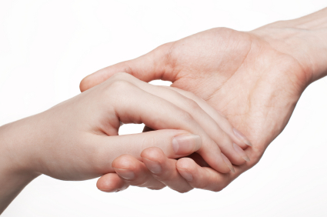

A Prayer for Our School
This is our school, let peace dwell here.
Let the rooms be full of contentment, let love abide here.
Love of one another, love of mankind, love of life itself and love of God.
Let us remember that, as many hands build a house, so many hearts make a school.
Amen.

Slide 28

Please join us as we sing,
‘One more step’
One more step along the world I go,
One more step along the world I go;
From the old things to the new,
Keep me travelling along with you:
And it's from the old I travel to the new;
Keep me travelling along with you.

Slide 29
Round the corners of the world I turn,
More and more about the world I learn;
All the new things that I see
You'll be looking at along with me.
And it's from the old I travel to the new;
Keep me travelling along with you.
As I travel through the bad and good,
Keep me travelling the way I should.
Where I see no way to go,
You'll be telling me the way, I know.
And it's from the old I travel to the new;
Keep me travelling along with you.

Slide 30
Give me courage when the world is rough,
Keep me loving though the world is tough;
Leap and sing in all I do,
Keep me travelling along with you:
And it's from the old I travel to the new;
Keep me travelling along with you.
You are older than the world can be,
You are younger than the life in me;
Ever old and ever new,
Keep me travelling along with you:
And it's from the old I travel to the new;
Keep me travelling along with you.

Slide 31
CLASS 5
COMMUNITY PROJECT
CRIMINAL DAMAGE

