Slide 1
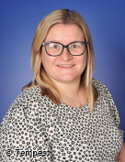
Meet the Teacher
Teachers-Mrs Wilkinson/Mrs Bluck
Teaching Assistance- Mrs Flintoff, Mrs Slater
Class 2

Slide 2
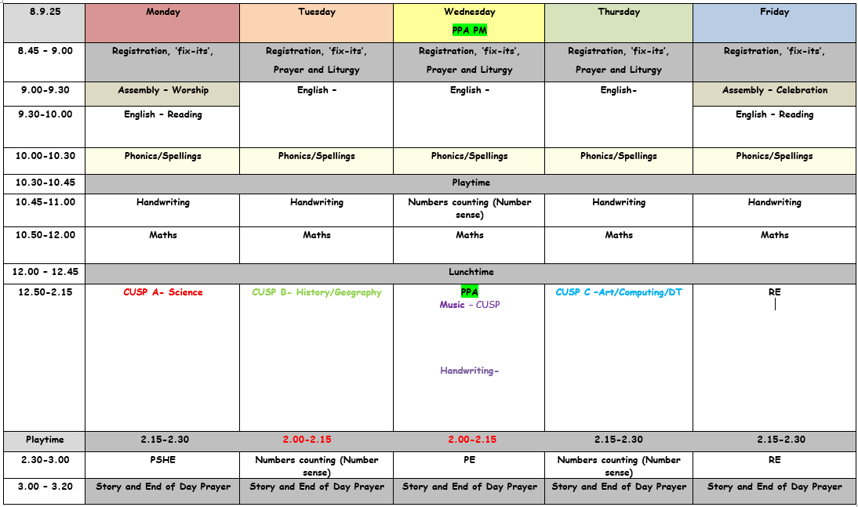
Timetable

Slide 3

Our behaviour system is called Track it Lights. It’s a traffic light system where the children are able to collect points towards their Bronze, Silver, Gold, Platinum and Diamond certificates. As well as rewarding children, we also use the ‘traffic lights’ as a warning system for behaviours which are not acceptable- Red track it points will be treated seriously.
As a class we have designed our very own class charter- The children have discussed and agreed what it means to-
be respectful, be ready to learn, show kindness, do our best

Slide 4


Reading books
Read every day
Ask the children questions about what they have read as you go along
Sound out any words using phonic sounds that the children are not sure of – phonic sound reminder on school website
As reading develops encourage expression and fluency
Record progress of reading reading record book
Bring reading bag to school every day
Look after reading book

Slide 5

PE
Every Wednesday afternoon.
Children come in their PE kits including trainers and jogging bottoms/shorts.
PE will be done outside whenever possible.

Slide 6
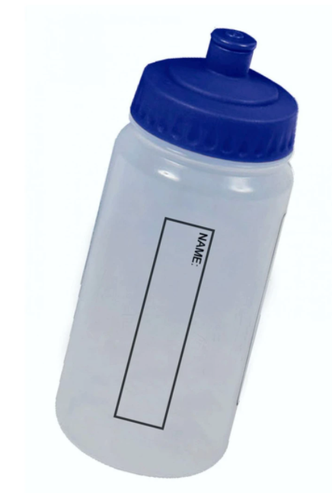
Water bottles
Important that the children bring their own water bottle to school every day to help with hydration in class and keep contamination to a minimum
No juice in bottles, just water
Please make sure you follow the guidance on bottle sizes so they can use their bottle holders on their chairs- no larger than 23cm diameter

Slide 7
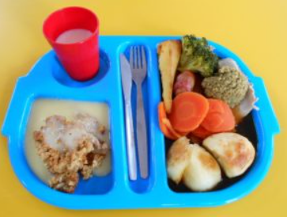
School Dinners
These are to be ordered weekly online.
Make sure the children know what the choices are and order something they like.
Dinners are made to order

Slide 8
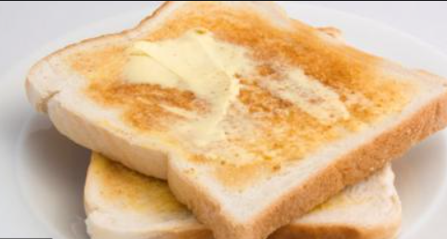
Break time toast
Toast can be ordered for morning break through parent pay.
This is done half termly.

Slide 9

Teacher contact
Contact me any time regarding queries or concerns on the email address:
bursar@st-annes.lancs.sch.uk

Slide 10

Useful websites
www.topmarks .co.uk
www.primarygames.co.uk
www.bbc.co.uk/bitesize/ks1/maths
www.bbc.co.uk/bitesize
www.wordhippo.com

