Slide 1
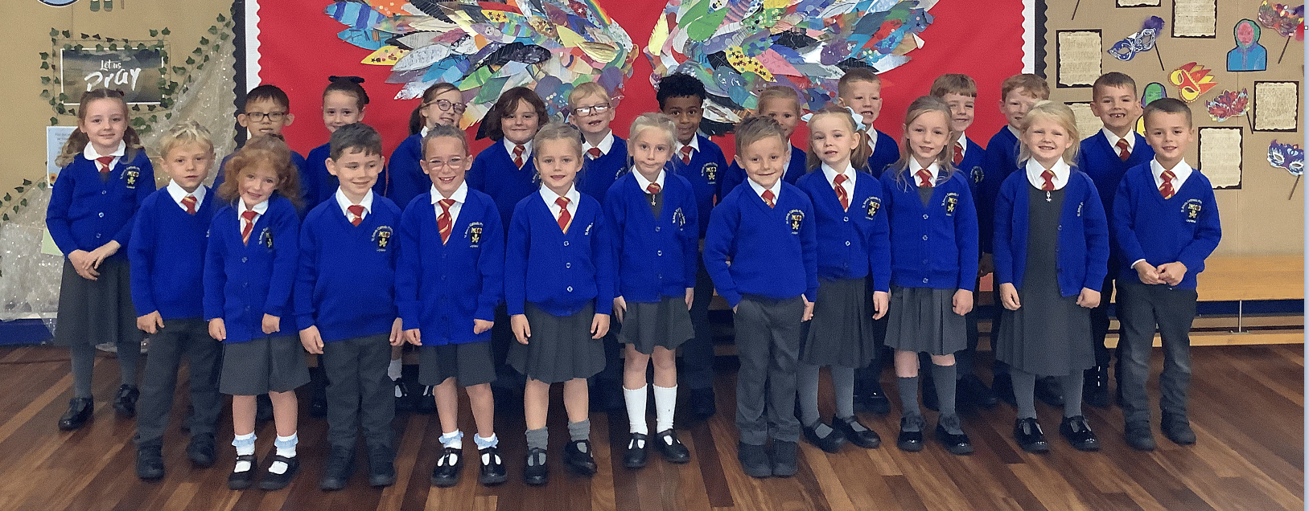

MUMMY
An Acrostic Poem by Year 1
With love for all our wonderful MUMMIES
Notes:
My Mum Is…” Lines
My mum gives the best cuddles.
My mum makes me laugh when I feel sad.
My mum reads the best stories.
My mum helps me learn new things.
My mum is brave and strong.
My mum is kind and gentle.
My mum makes yummy dinners.
My mum helps me when I’m stuck.
My mum is my hero.
My mum makes everything better.

Slide 2

👩‍👧 M
My mummy is caring and kind every day

Slide 3

U
Under her smile, my worries melt away

Slide 4

🌱 M
My mummy helps me learn and grow

Slide 5

🏡 M
My mummy makes me feel safe wherever I go

Slide 6

⭐ Y
You’re the best mummy — We love you so

Slide 7

🌷
Happy Mother’s Day

