Slide 1
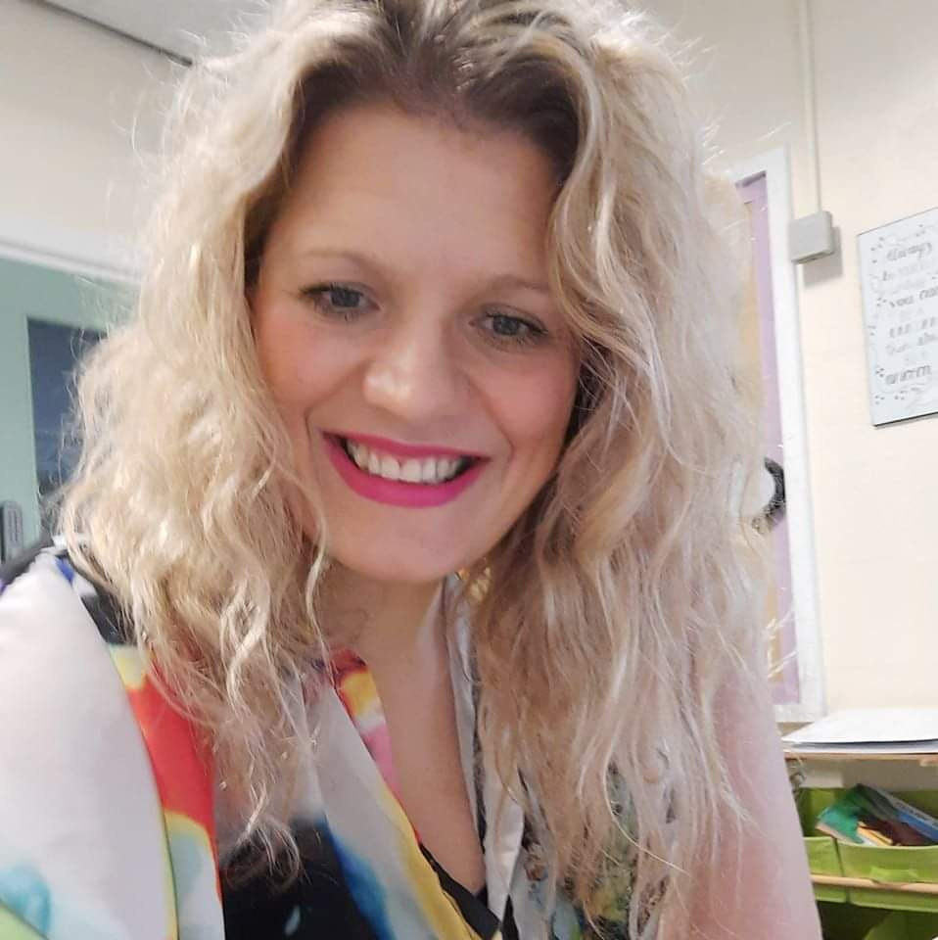
Class One
Meet the Teacher
Miss Butterworth
(Class Teacher)
Mrs Wilson (TA am)
Mrs Slater (TA pm)
Mrs Seed (TA full time)

Slide 2
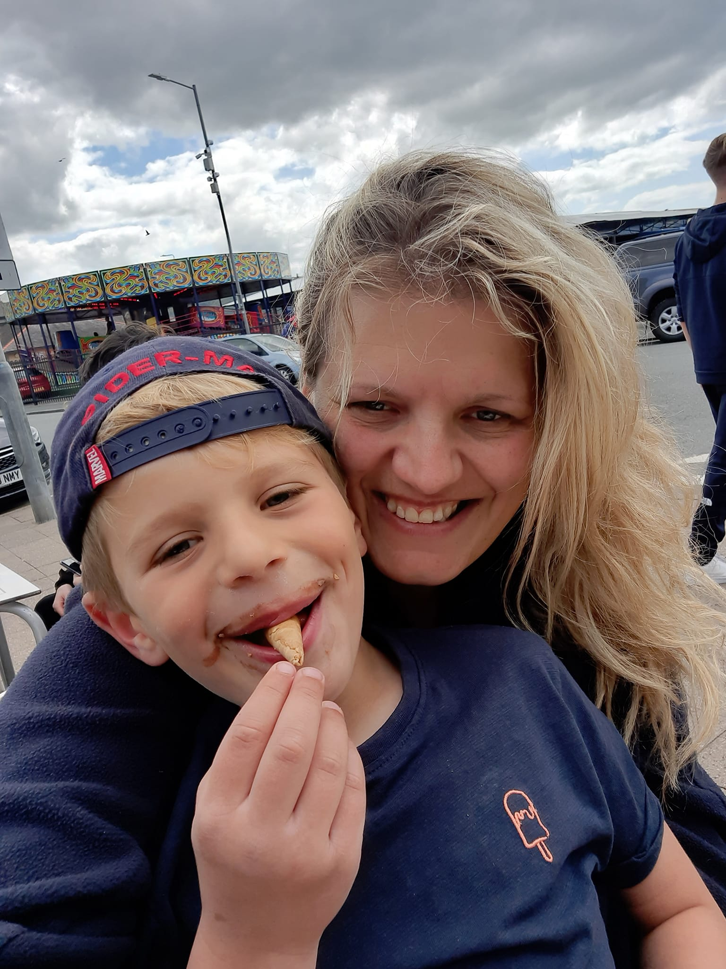
Hello Year 1 parents,
Miss Butterworth here! Here’s a little about me. I have been a teacher for 18 years. I love teaching reading, writing and topic. I am the school SENCO and I am passionate about making sure every child reaches their potential. My SENCO role means I am out of class on a Friday so Mrs Websdell teaches class 1 then.
I have a little boy, Max. He is 6 and just going into Year 2. I look forward to getting to know all your children and delivering an exciting and enriching curriculum.

Slide 3

PE day: Monday with Miss Butterworth and then again on Thursday with the Sports Coach and Mrs Astley. Children need to come to school wearing their full PE kit on this day. (Coloured house team top, sports jumper and black/blue joggers, with comfortable black/blue trainers.)
Reading books: Reading books will be changed every Monday. The children will have guided reading every Tuesday afternoon so there is an opportunity to read the book with your child prior to their guided reading session.
Homework: Homework and spellings will go out on a Friday and comes back in on the following Thursday. This will include English, Maths and spellings. The children will bring their homework in their homework book, or it will be posted on seesaw depending on the task. Please do look after these books, they are only to be used for homework. Spellings will be tested on a Thursday morning.
WATER BOTTLES: Please can all children bring in a water bottle for the classroom, this is separate to any lunch box water bottles as the children aren’t allowed back in class over lunch as there are no adults to supervise.

Slide 4
Timings for the day
Snack and Lunch time
Beginning of the day: The children will be collected from the playground at 8.45.
Break: 10:15-10:30
Lunch: 12.00-12.45
Afternoon play: 2.15-2.30
End of the day: 3:20pm
Hot dinners: These should be ordered on the app each day, or you can order for the whole week.
Snack: Toast and Fruit toast is available for pre-order at the office, but please ensure this is done before the term starts as there are a lot of children who have snack.
Children are welcome to bring their own healthy snack for morning break.
Children will have fruit provided for afternoon play

Slide 5
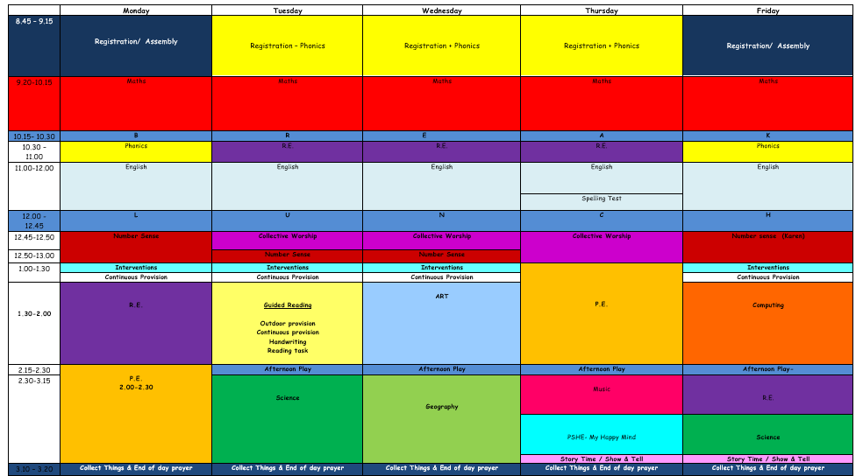
This is the timetable overview in year one for the week. As you can see, there is a lot to fit in, so it is crucial that the children are listening and following instructions carefully to ensure all children have the best possible chance of enjoying themselves and making progress.

Slide 6
For further information please check the weekly school newsletter. Please also be aware that I may also send messages via the school app.
Please don’t hesitate to catch me for a brief chat on the playground or to make an appointment at the office. You can get in touch via email using the following address bursar@st-annes.lancs.sch.uk.
I look forward to meeting you all soon at parents evening.
Best wishes,
Miss Butterworth

